Slide 1
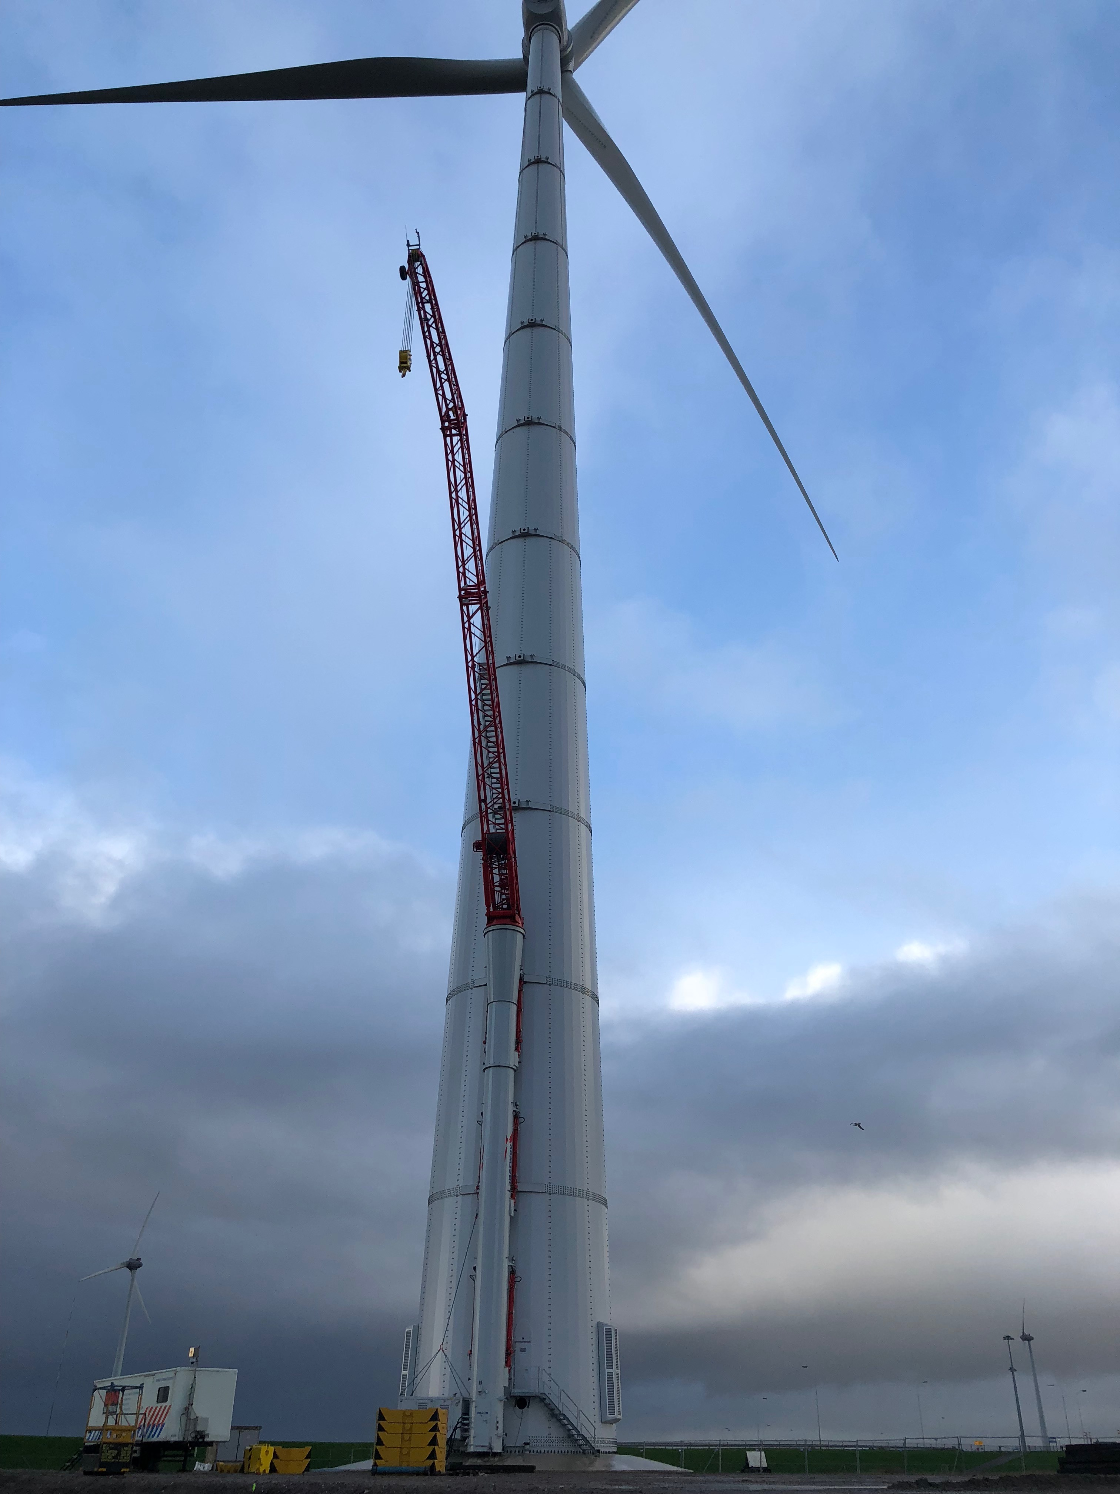


Condition-based maintenance optimisation of wind power turbines
Bram Klein Kranenbarg
Thursday, 15 November 2018

Slide 2



8000+ components¹
500+ measured parameters
Significant costs
$
High failure rate

Slide 3





1. Data
2. Method
3. Analyze
4. Simulate
5. Strategy
- Five years
- Most impact
Parameter value
Condition status
Degradation process over time
- Degradation
- Wind
- Costs
- Two thresholds
- Timing maintenance
“Modelled degradation process based on system data is innovative and very accurate”

Slide 4


Actual system data
Comprehensive applicability
52%
Costs reduction for Lagerwey

Slide 5

Thank you!
For your attention

