Slide 1
Dynamic Dispatching and Repositioning Policies in Service Logistics Networks
Collin Drent
joint work with Geert-Jan van Houtum (TU/e) and Minou Olde Keizer (CQM)

Slide 2
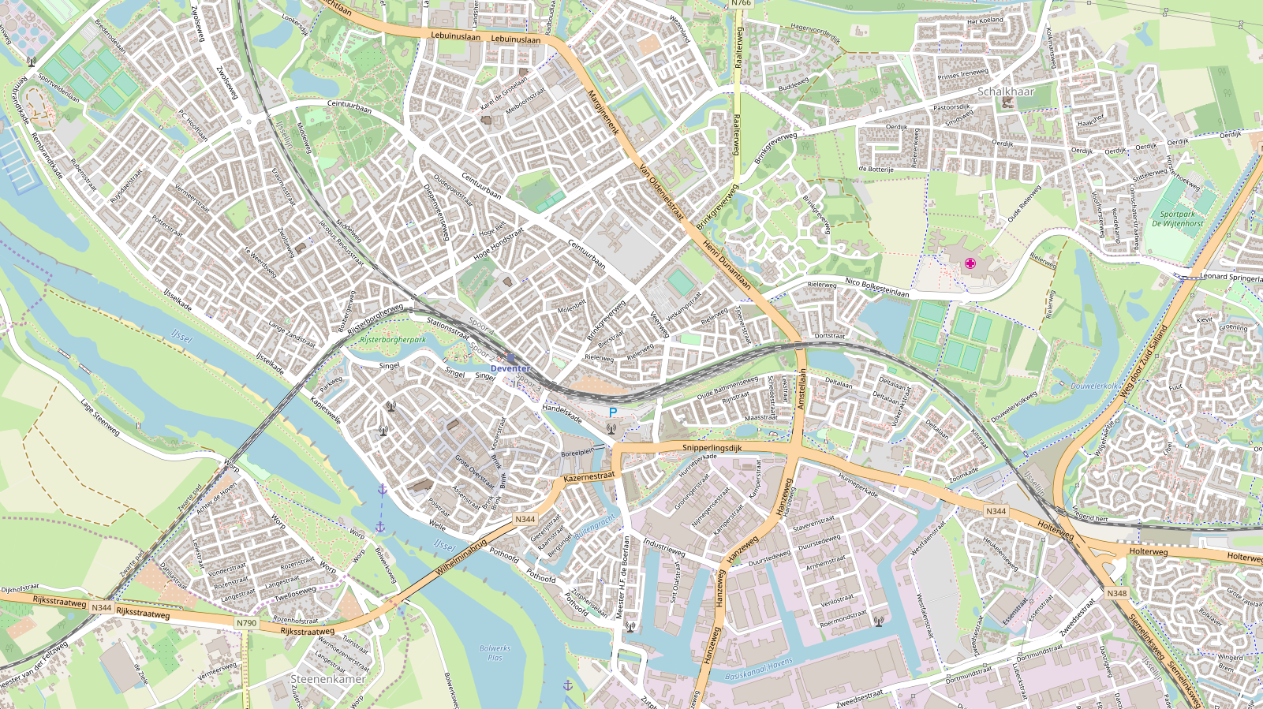




Slide 3
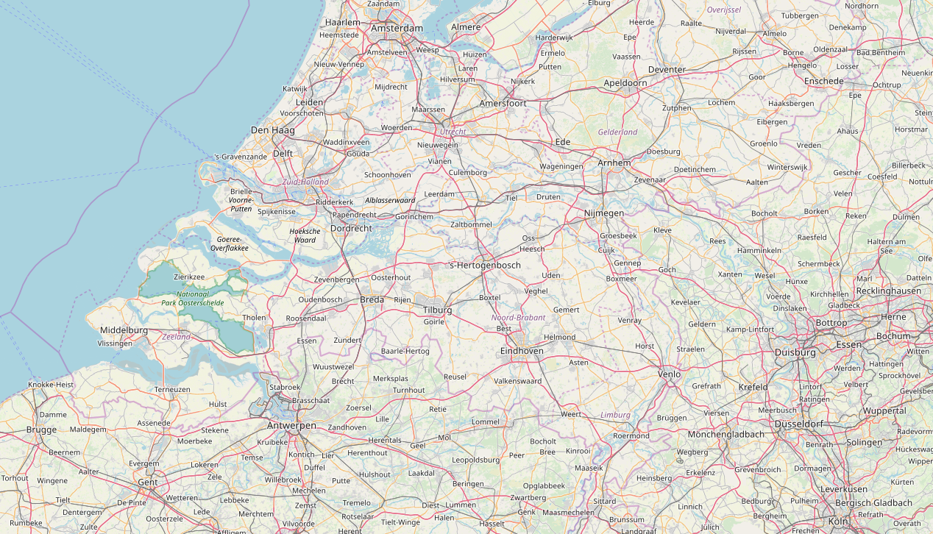


Slide 4
Online Algorithm
Input
Real-time locations
Timing of service requests
Algorithm
Minimize costs
  Travelled distance
  Penalty costs
Maximize future coverage
Output

Slide 5
Easy to implement
Instant online decision-making

Slide 6
Cost savings
-58.1%
100%
-60.1%
-2%
41.9%
39.9%
Static Policy
+ Dynamic Dispatching
+ Dynamic Repositioning

Slide 7



Joint work with Geert-Jan van Houtum (TU/e) and Minou Olde Keizer (CQM)

