Slide 1



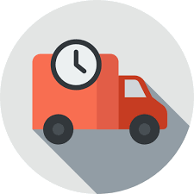



Every value chain is only as
strong as its weakest link.
We make your business talk.

Slide 2
Predictive components utilisation and value optimization
Is my supply chain resilient?
First time right
Servitization, can we reduce # parties involved?
High # of emails
documents
Inventory costs
Is real time dynamic planning possible?
Can I avoid unnecessary trips field engineers?
Improve safety management
Dispatch, reposition, reallocate

Slide 3
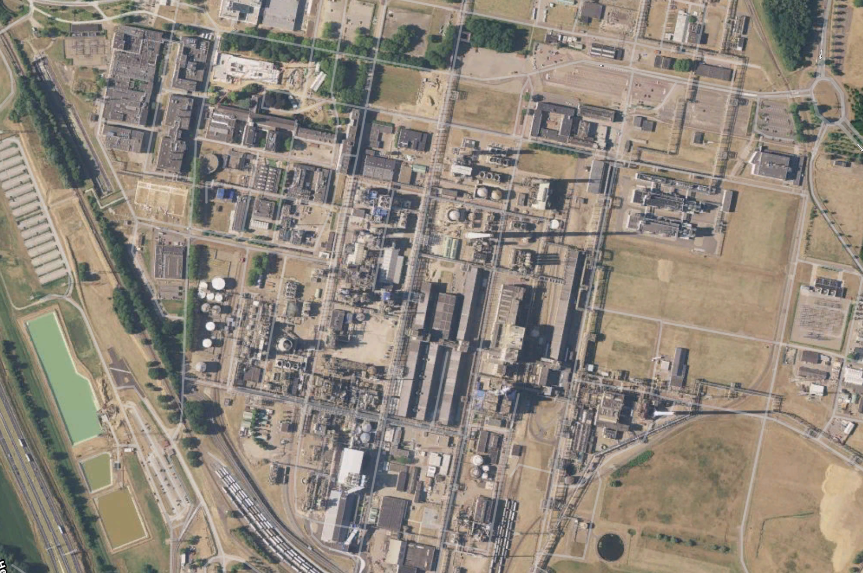

Parking monitoring
Gate-In monitoring
Standtrailer management
Field engineer/Man down alert
OUR SENSORS TURN DATA POINTS INTO ACTIONABLE INSIGHTS, PROCESS MINING, AI...
Smart beaconing
Visitor safety
Cargo Tracking
Railyard maintenance

Slide 4
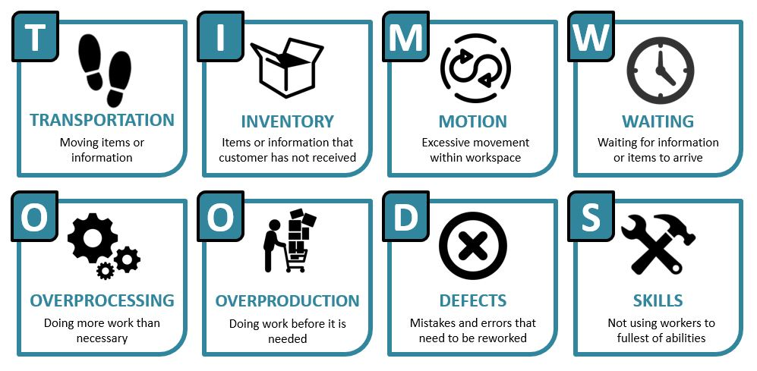
IOT makes Tim Woods really smart

Slide 5

IoT – Love at first sight

Slide 6
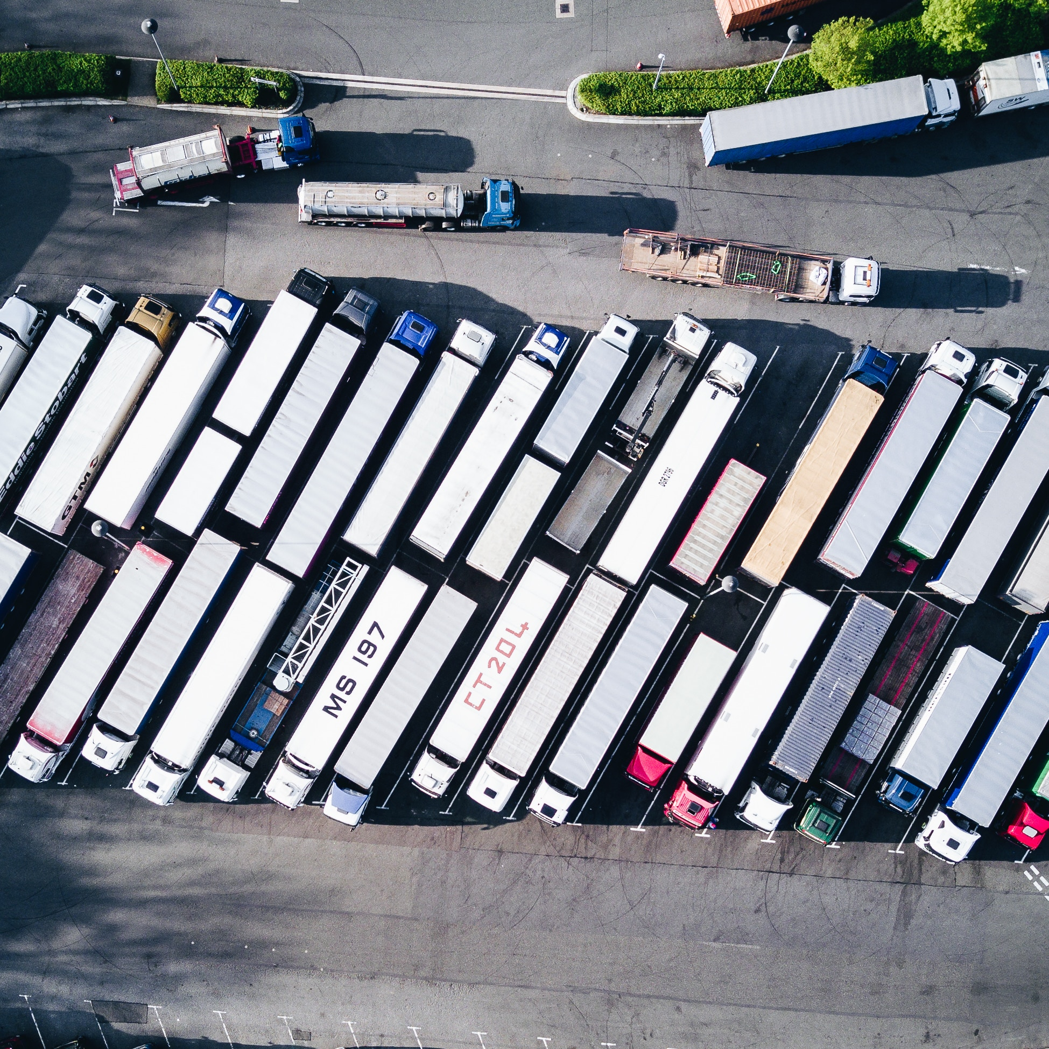
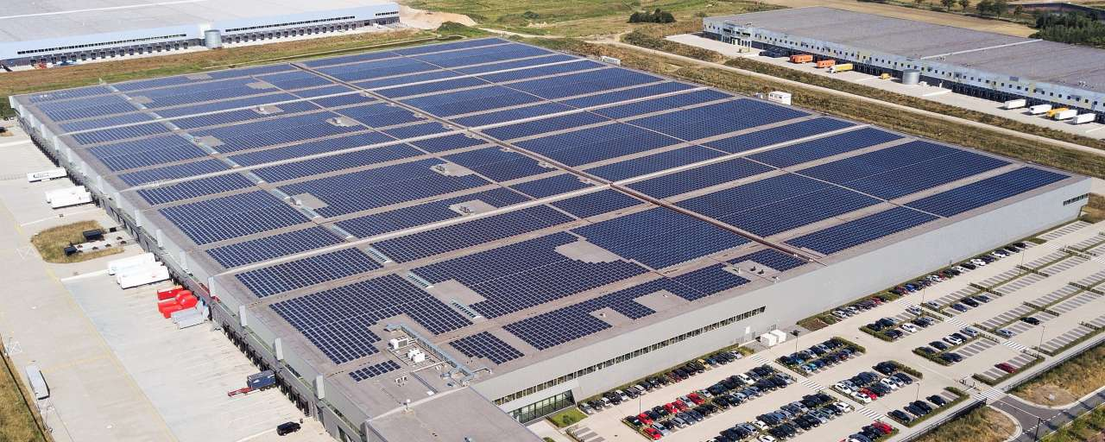

Self organising logistics

Slide 7
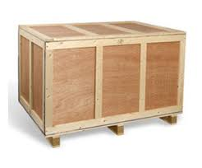
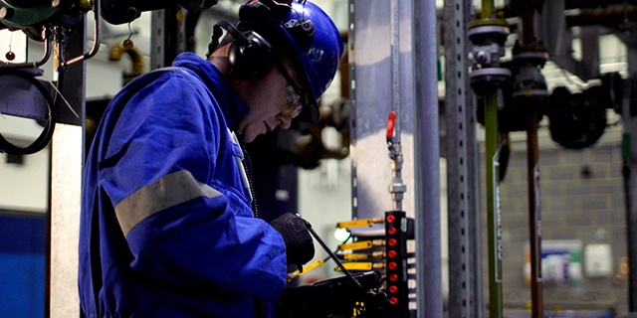
Smart dispatch and repostioning

Slide 8
With IoT to Smart (Circular) Tim Woods and
(autonomous) fast forward supply chains

