Slide 1


Service Logistics Innovation Symposium
Round table discussion
Real-time Uptime in High Tech
Rob Basten & Ramon Caanen

Slide 2
Agenda
Visioning, inspiring, community building
Real-time Uptime in High Tech
Short introduction roundtable participants
Visioning – based on recap ‘Innovations: dreams or practice’
Discussion round:
    What is the biggest bang for the buck?
    Where are you?
    What are your main challenges to overcome?
Introduction ‘DISRUPT’:
    Dutch Innovation in After Sales Services - Real-time Uptime in High-Tech

Slide 3






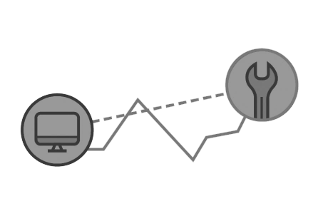













Innovations: dreams or practice?
JIT maintenance enabled by remote condition monitoring!
Real-time Uptime in High Tech
Early demand information will be used to push inventory back into the supply chain…
IoT
Cloud computing
Opportunity for OEMs to offer performance based logistics?
Spare Parts pooling?
Predictive maintenance!
Remote condition monitoring
JIT availability of parts & engineers!
ProSeLoNext, F35

Slide 4







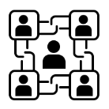




Innovations: dreams or practice?
Adaptivity through remote control tower technology!
Real-time Uptime in High Tech
Intelligence amplification
Artificial Intelligence
Machine learning
Big data
?
Blockchain
IoT
Cloud computing
Smart bots
High uptime!
Action plan
Intervention
Real-time information sharing
Marconi, ProSeLoNext

Slide 5





Innovations: dreams or practice?
Remote diagnostics enables lean supply chain!
Real-time Uptime in High Tech
Remote diagnostics reduces unnecessary site visits and uncertainty in the repair process
Opportunity for OEMs to offer uptime based contracts?
Centralization of skills through augmented reality
Short repair lead times!
Failed parts inspected upon failure!
Drone inspections

Slide 6







Innovations: dreams or practice?
High responsiveness through instantaneous supply…
Real-time Uptime in High Tech
Opportunity for OEMs to offer performance based logistics?
Parts are printed on demand or self-healing!

Slide 7


Challenge: how to realize more impact?
What are the most promising topics & developments?
Real-time Uptime in High Tech
“Biggest bang for the buck”:
Control towers
Artificial Intelligence
Big data
Additive manufacturing
?
Impact
Blockchain
Intelligence amplification
Remote condition monitoring
Investment (€)

Slide 8
DISRUPT
Dutch Innovation in After-Sales Services – Real-time Uptime in High-Tech
By 2030, manufacturers will need to drastically alter the after-sales services they deliver, how they deliver them, and how they profit from them
Intensified collaboration between companies
Smart use of new technologies
    The Internet-of-Things, artificial intelligence, 3D printing, and drone deliveries
Orchestration of the delivery of after-sales services by a central global control tower
    Human planners interact with decision support systems with built-in artificial intelligence
New business models and contract forms
    Both customers and manufacturers benefit
    Equipment is returned to the manufacturer at the end of the life cycle

Slide 9
DISRUPT – Content
WP1: New technologies in after-sales services
How to incorporate new technologies into service supply chains for capital goods?
WP2: After-sales service control towers
How to make operational level decisions using tactical plans, huge amounts of data, and expert knowledge?
WP3: Transition enablers
How to enable after-sales service supply chains using adaptive information architectures?
WP4: Business models for smart services
How to develop evidence-based managerial design guidelines for companies that aim to make the transition from product-led to service-led after-sales services?
WP5: Valorization

Slide 10
DISRUPT – Consortium
In various stages of discussion:
ASML
IBM
Lely
Marel Stork
Océ
Philips
Thales
Vanderlande
Fokker Services
Ministry of Defence
InnoPay
ORTEC
Eindhoven University of Technology
Tilburg University
University of Twente
Erasmus University Rotterdam
Rotterdam University of Applied Sciences
Saxion University of Applied Sciences
Breda University of Applied Sciences
Service Logistics Forum
World Class Maintenance
Logistics Community Brabant
Link Magazine
Valorisation partner(s)

Slide 11
DISRUPT – Further information
Proposed project size: 5-6 M€
Announcement & pre-proposal submitted
Now working on full proposal with deadline in December
You are very welcome to join!

