Slide 1

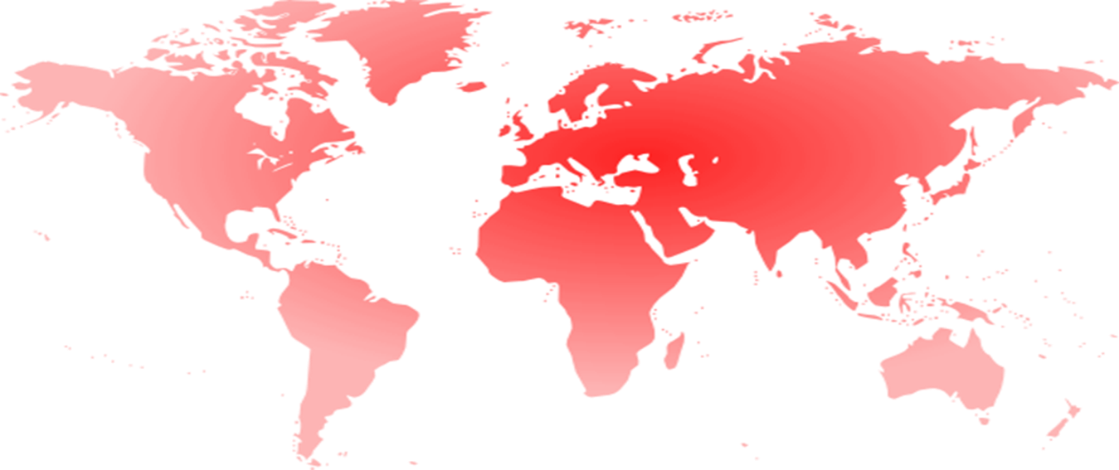
Katoen Natie
June 4th, 2015
Commitment
Customer Focus
Flexibility

Slide 2
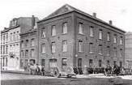
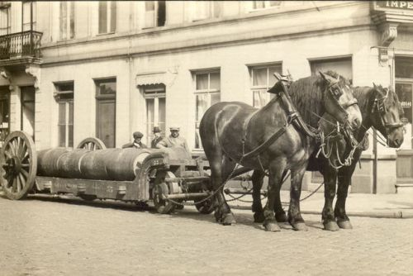

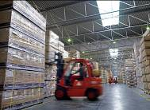
History
      Incorporation
      Handling and storage of commodities (cotton).
1855
      Expansion of markets
      Consumer Goods, Petrochemicals, Industries.
1980
      Vertical integration (4PL)
      Customs clearance, transport management, …
1984
      Internationalisation
      Europe, North and South America, Asia, Africa.
1993
      10.000 employees in 34 countries
2012

Slide 3
Mission
  Core business:
  Through investing in:
  Strong focus on:
As a long term, reliable Partner for our clients, it is our mission to offer
flexible, high-quality logistics solutions and continuous improvement as a competitive advantage for each client.
Warehousing and value added logistics
Large-scale multi-customer platforms
State-of-the-art engineering and IT

Slide 4

Values & Philosophy
Mother – baby principle
Hands-on mentality
Challenges
Fast-decision making
Our people
Passion
Decentralisation
Can-do attitude
Dynamic
Trust
Client focused
Delegation
Respect
Commitment
Innovation
Dedication
Creativity
Leadership
Sustainable

Slide 5
Key Data
Structure
Privately owned company
Headquarters
Antwerp, Belgium
Turnover
€ 1,1 Billion
Employees
13,000
Countries
32
Logistics platforms
154
Covered warehouse capacity
4 500 000 m²

Slide 6
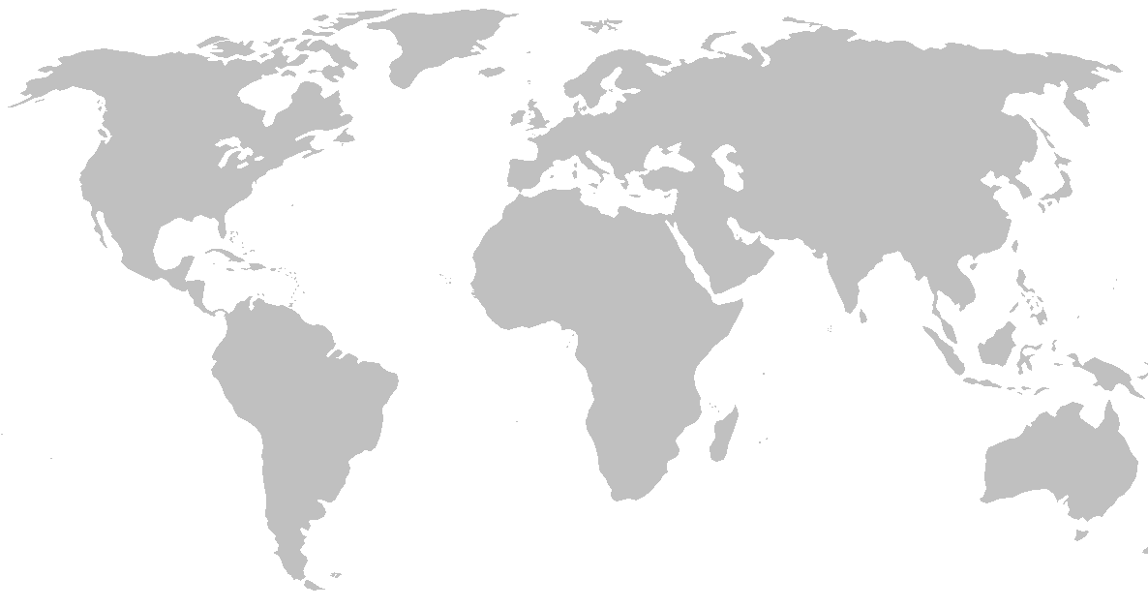
Global coverage
Belgium
Brazil
Cameroon
Canada
Ivory Coast
Estonia
France
Germany
Ghana
India
Italy
Luxembourg
Mali
Mexico
Moldavia
Netherlands
North-America
Poland
Saudi-Arabia
Singapore
South-Africa
Spain
Sweden
Thailand
Turkey
United Kingdom
Uruguay
Vietnam

Slide 7



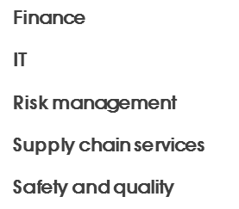



Philosophy
Finance
Culture
IT
Values
Risk management
Supply chain services
Safety and quality
waste
processing
supply
chain
engineering
process
engineering
petro-
chemicals
specialty
chemicals
consumer
goods &
industry
port
operations
general
cargo &
commodities
food &
feed
waste
management
art

Slide 8



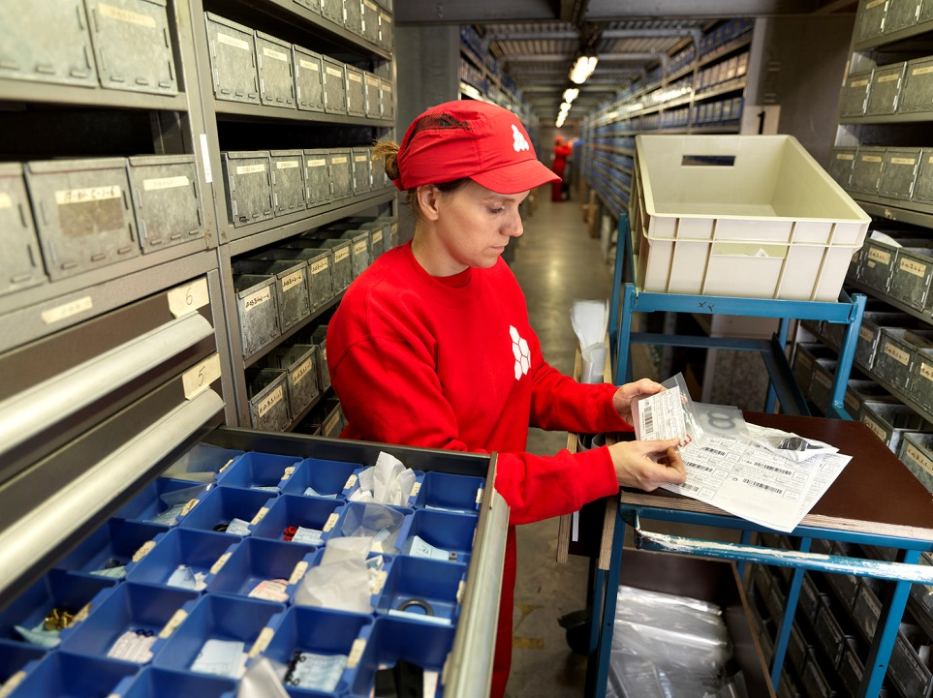








Business
lines
Aftermarket logistics

Slide 9

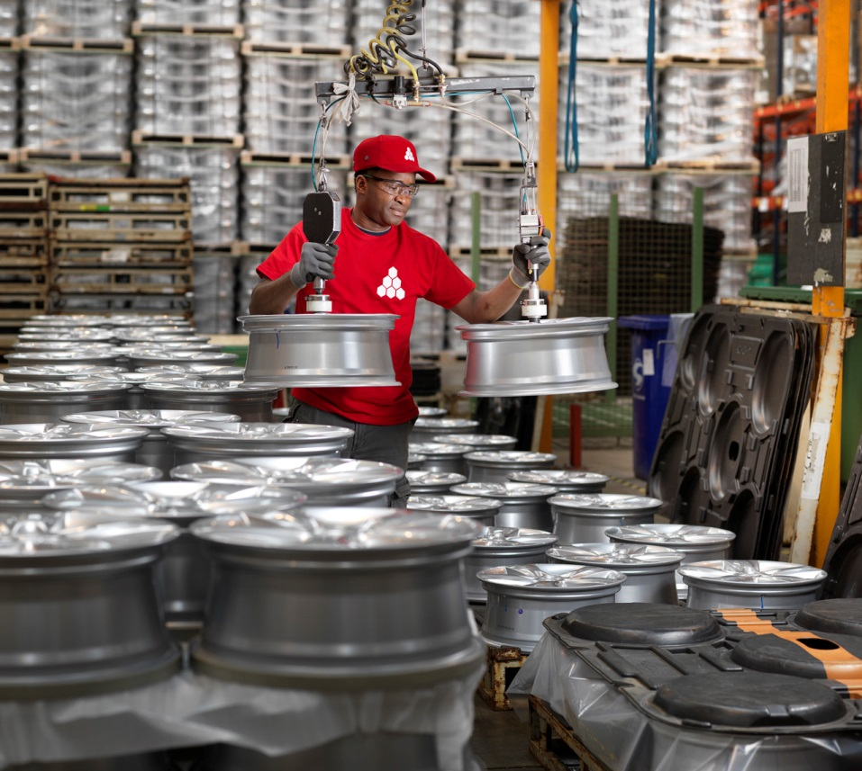
Business
lines
Automotive & Industry

Slide 10

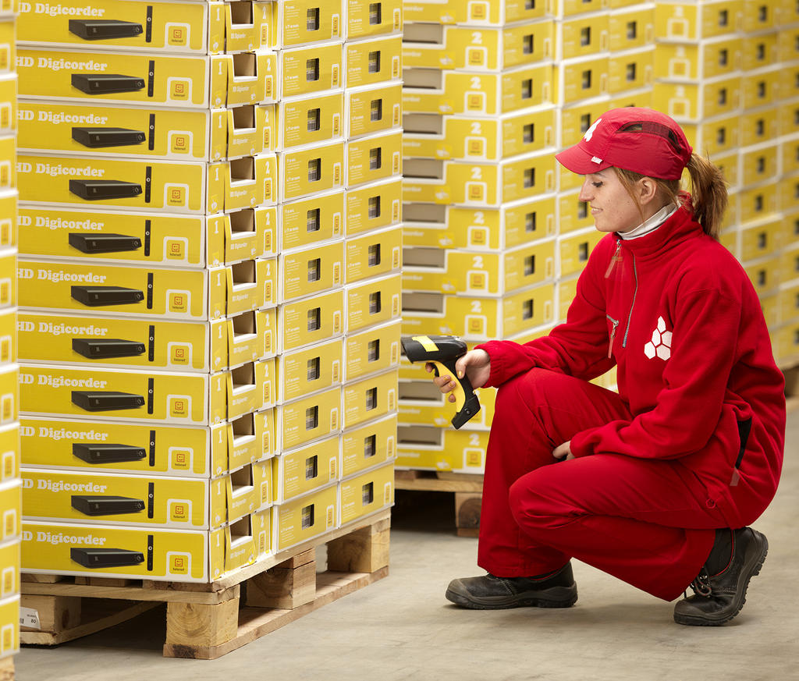
Business
lines
Consumer electronics

Slide 11

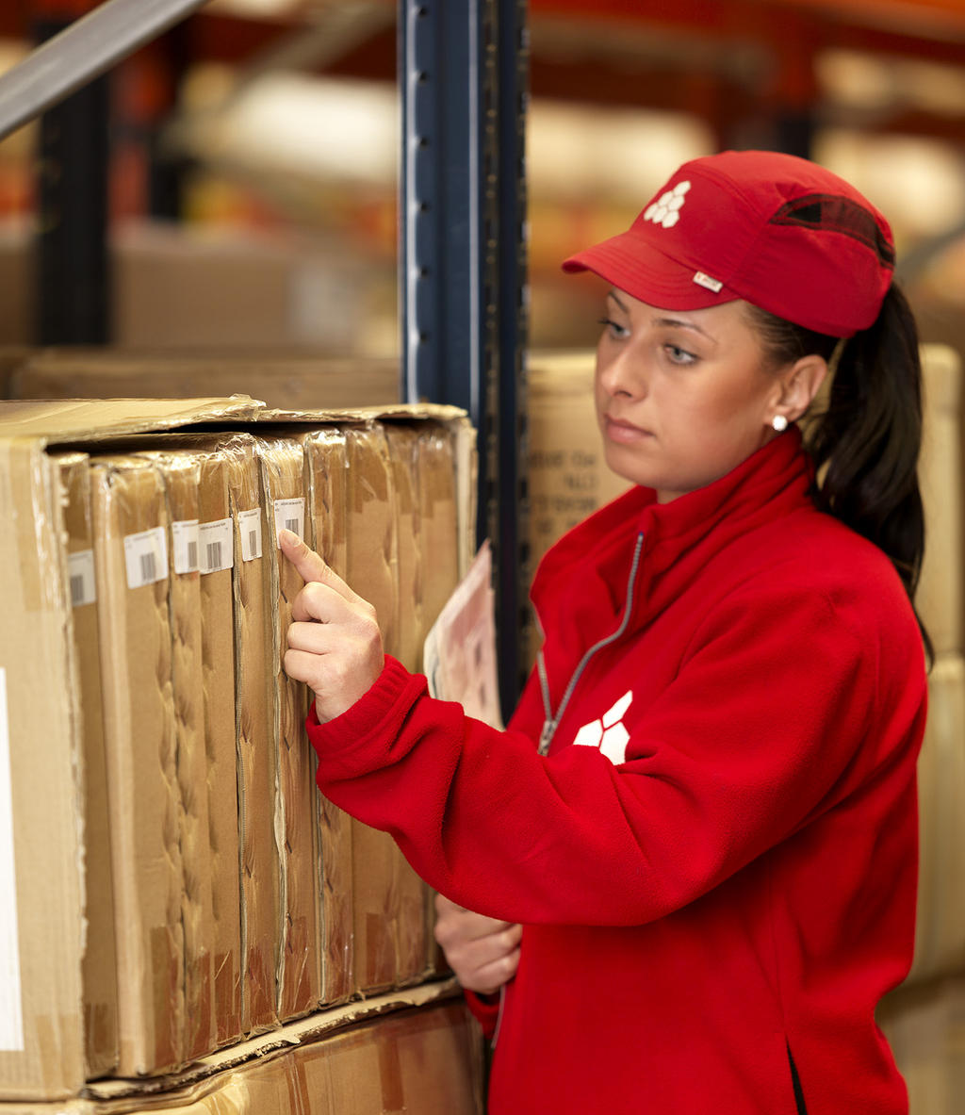
Business
lines
Do-It-Yourself

Slide 12

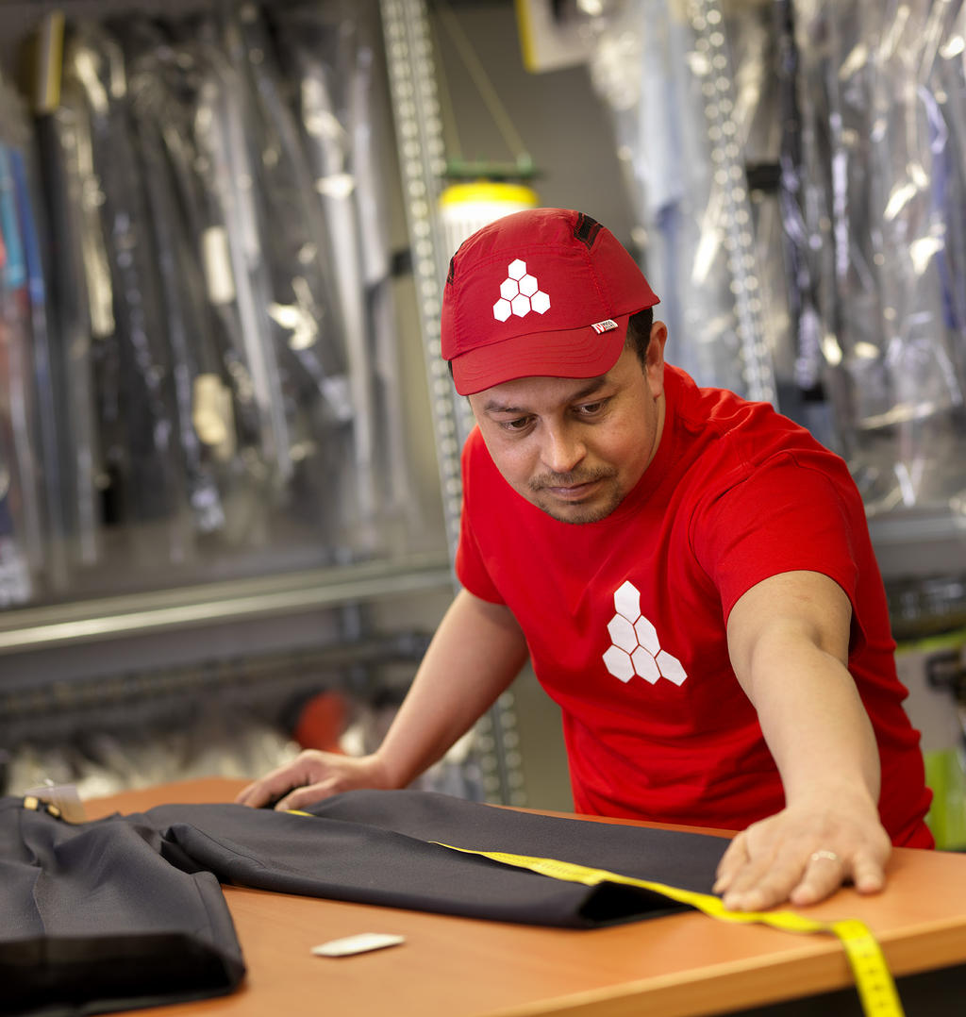
Business
lines
Fashion & work apparel

Slide 13

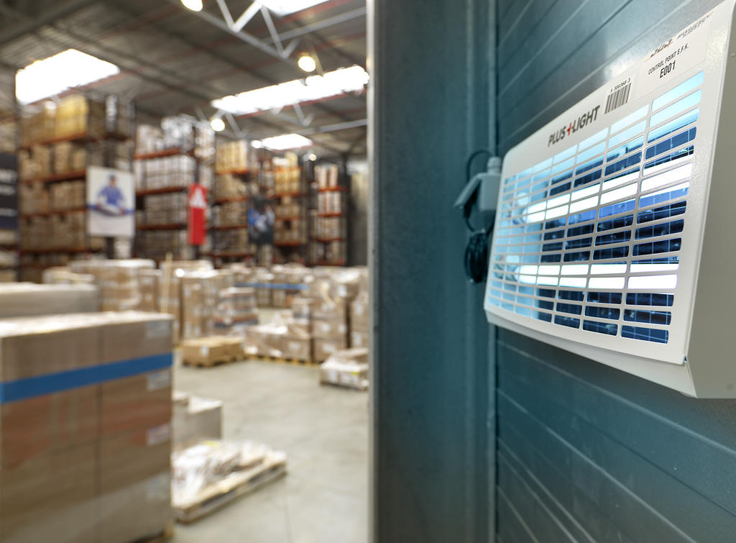
Business
lines
Food & feed

Slide 14

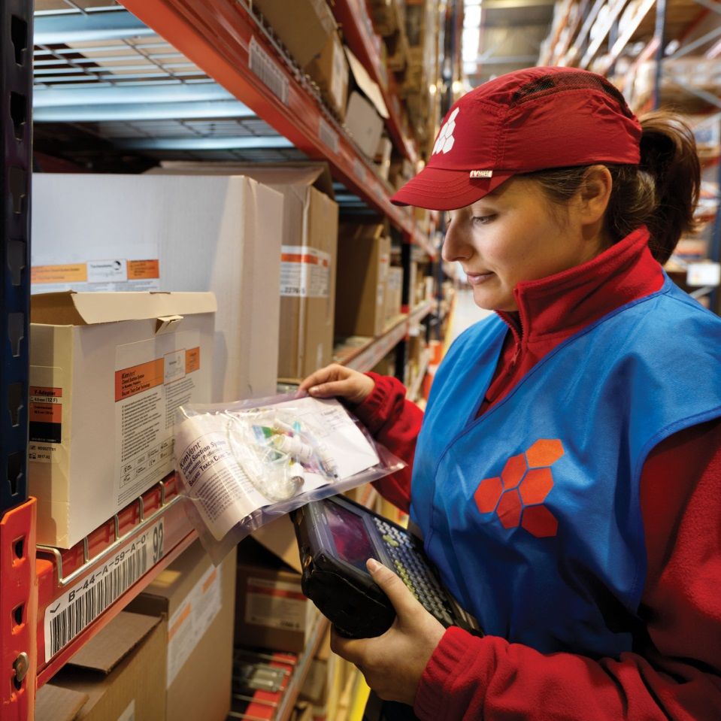
Business
lines
Health- & personal care

Slide 15

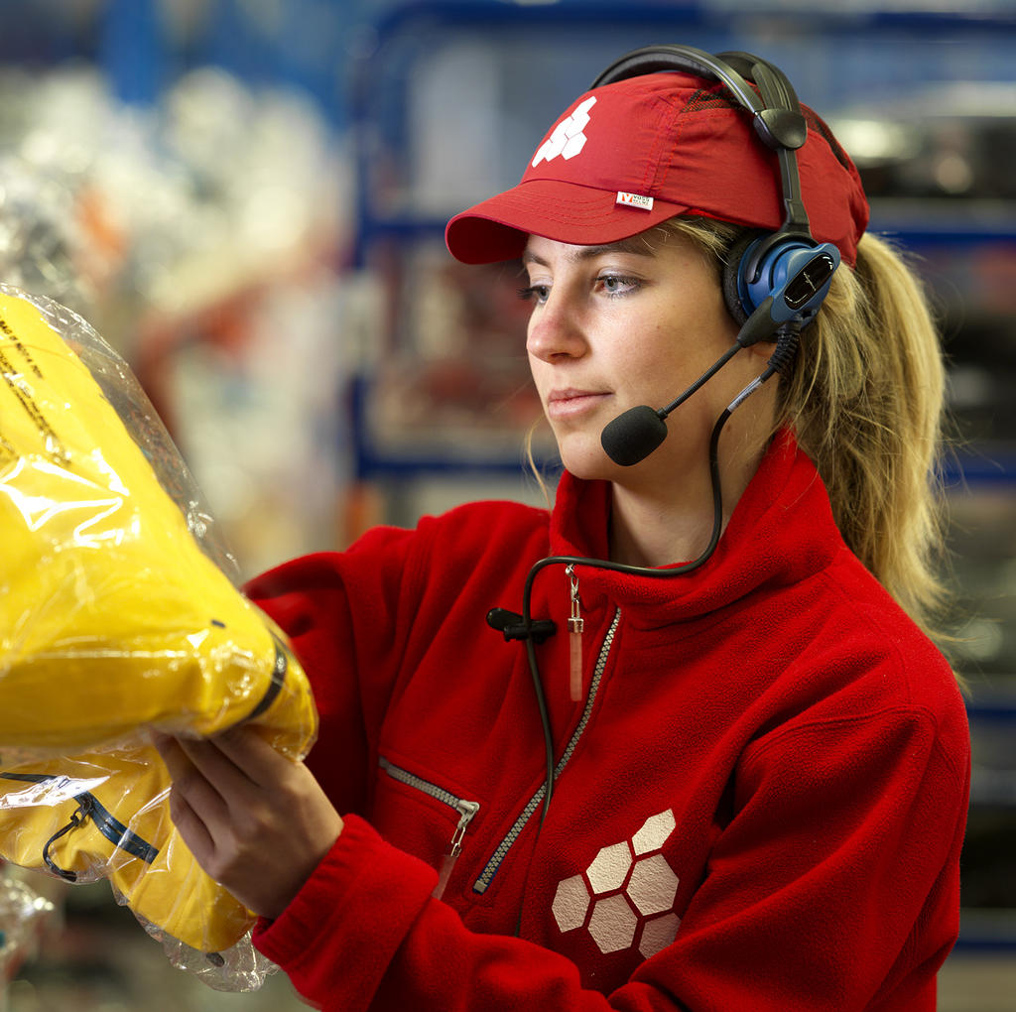
Business
lines
Omni-channel & E-commerce

Slide 16

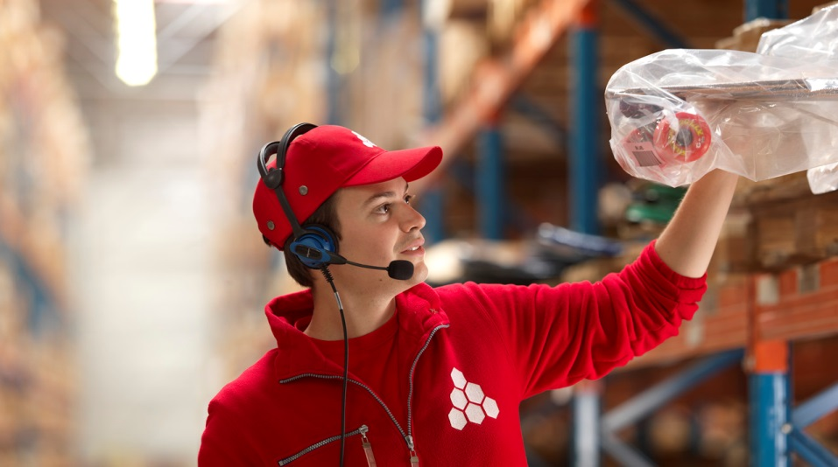
Business
lines
Sports, leisure & toys

Slide 17
Katoen Natie Kallo – Q1998
Commitment
Customer Focus
Flexibility

Slide 18
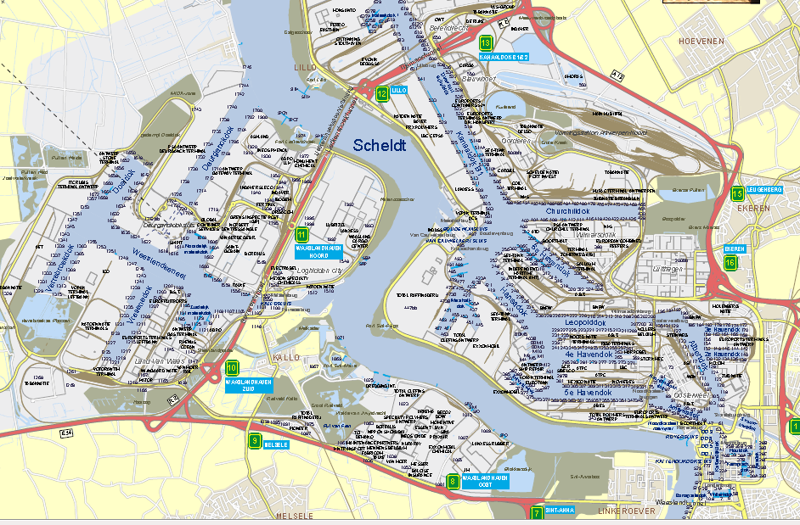
Katoen Natie in Antwerp

Slide 19
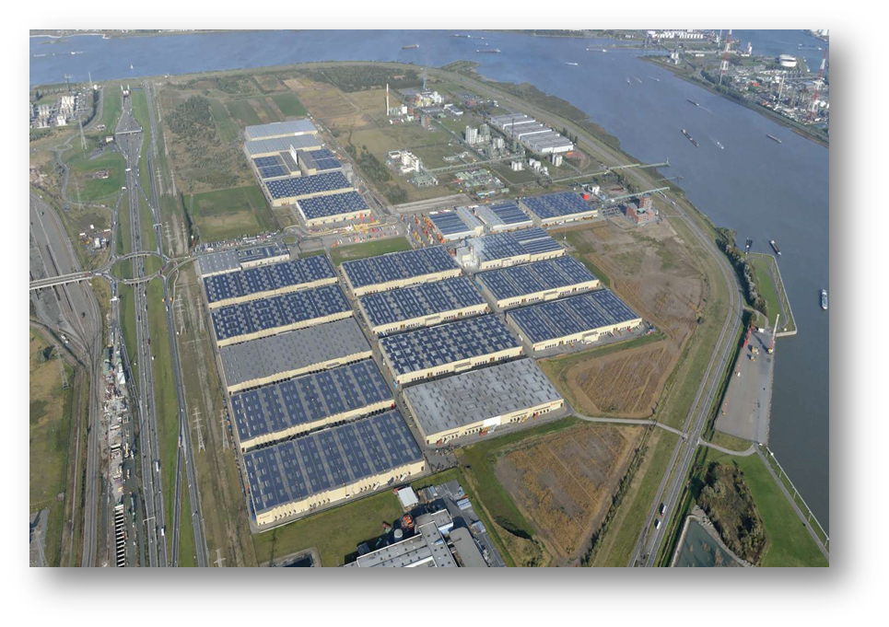
Intermodal Mega – Import Logistics Site
The advantage of a multi-customer platform
  Economy of scale, cost leverage, capacity, flexibility …
Central point for European Distribution
  > 20 carriers and hauliers with EDI connections
  Centrally Located between Germany, France, UK, BNL
  An attractive tax environment
The European logistics location for inbound flows
  Located in the Port of Antwerp
  800 000 m² of covered warehouse capacity
Flexibility in real estate and resources
“In house” Forwarding and Customs Dept.
Tailor made WMS - solution
Neutral Transport Management

Slide 20
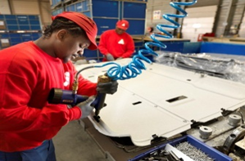
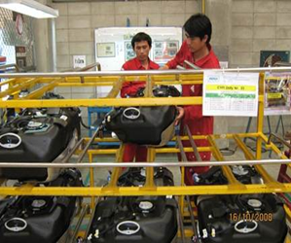
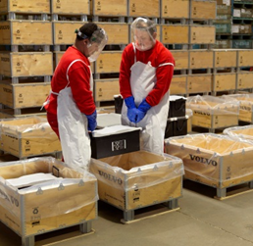
Logistics flows & Value Added Services
Production Logistics
Distribution Logistics
Packaging Logistics
Warehouse Management activities (WM)
(Re)-packing
Assembly in batch
Batch delivery (JIT, KANBAN, L3P)
Sequencing (JIS)
Assembly In Line Sequence
Kitting (In Line Sequence)
KD-activities: CKD & SKD
Functional testing
Reworks & Repairs
Returnable packaging management
Material requirements planning
Line feeding
Parts Identification
Picture management
Receiving versus PO, DN, Invoice
Sorting
(Re)-packing
Kitting
Assembly
Labelling
Picking (Mono-, Multi-order and Batch)
Packing
Track & Trace
Order consolidation
Reverse logistics
Reworks & Repairs
Refurbishment
Sorting mixed packaging
Repair wooden & plastic packaging : pallets, frames, lids, spacers, FLC – FXC
Cleaning & Drying: KLT, boxes, lids and spacers
Metal repair & welding
Maintenance , refurbishment and adaptation
Environmental waste management
Pool management

