Slide 1
Farming 4.0
The influence of After Sales
Martijn Holten

Slide 2
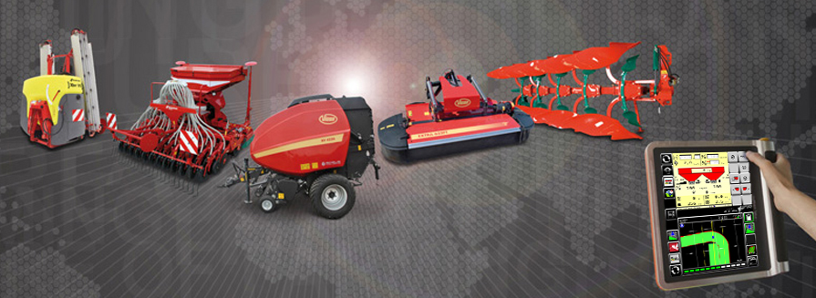
Products

Slide 3

Provide the Best Service to make
everyday life easier for our customers

Slide 4
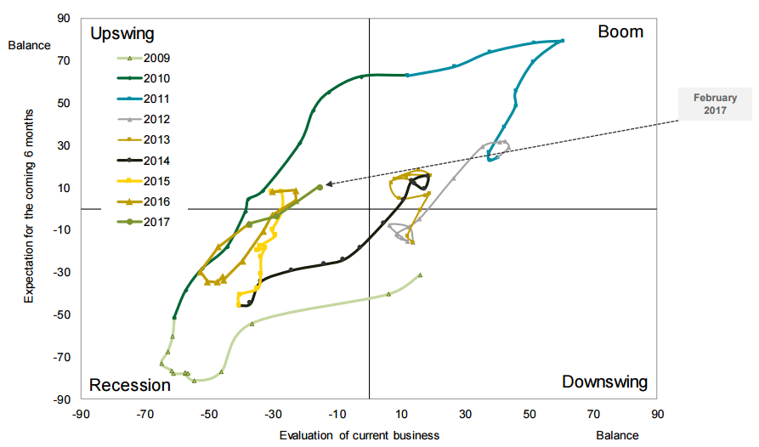
Illustration of Business Cycle

Slide 5
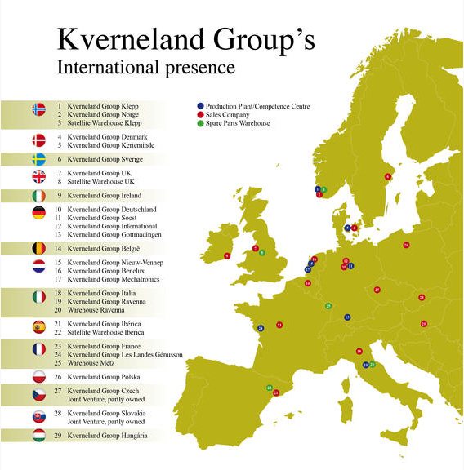


Slide 6
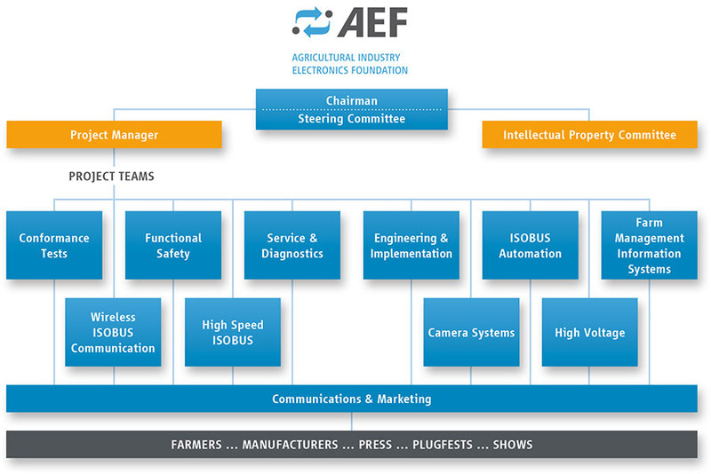
AEF – World Wide Cooperation

Slide 7
Global Food Challenge
Global population:
2025 → 8 billion people
2050 → 9.6 billion people
2050 → Food production must increase by 70%
History of mankind until now = amount of food = from now until 2050

Slide 8
Key constraints agriculture is facing:
Slow-down in productivity growth
Limited availability of new arable land
Climate change
Price and availability of energy
Impact of urbanization on rural labor supply

Slide 9
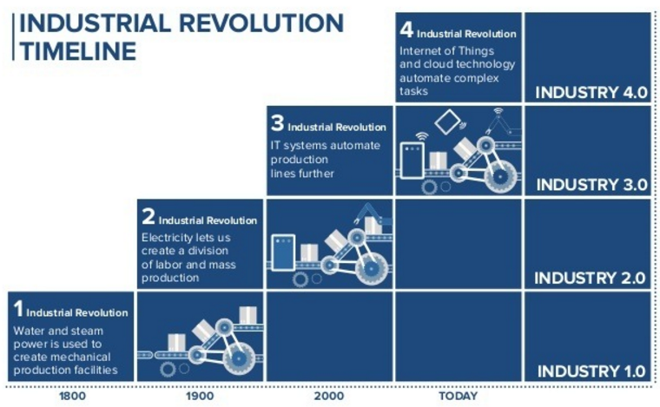
Farming 4.0

Slide 10
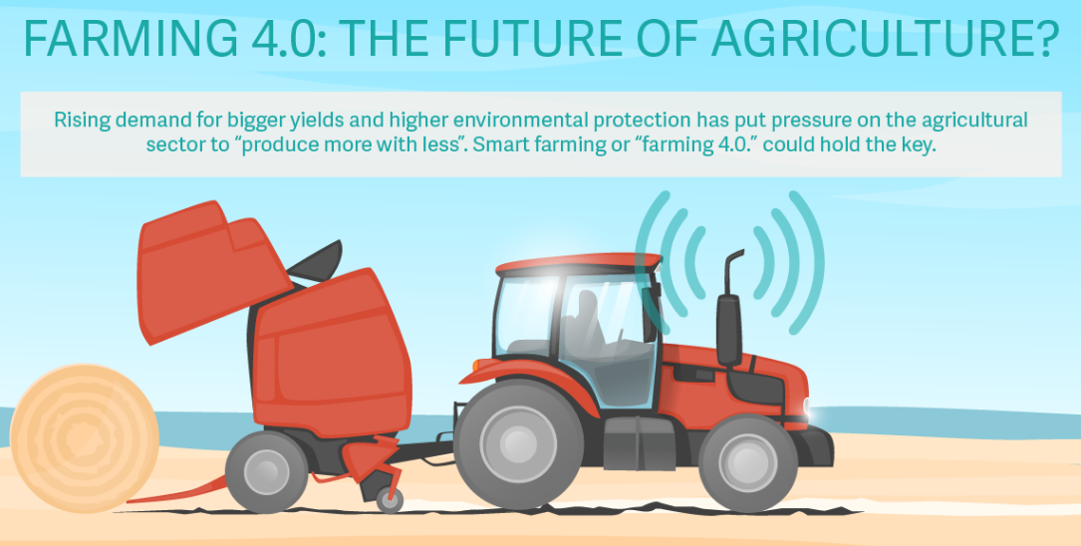
Smart Farming
After Sales has a key role

Slide 11
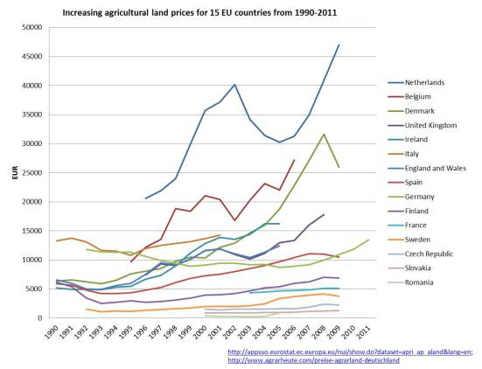
Strength of the Netherlands

Slide 12
Strength of After Sales Service
After Sales has the technical knowledge and experience to cope with Industry 4.0.
Support of high-end and complex products
Communication platforms
Solution offering and new developments (including existing products)
Change of business models

Slide 13

Support of high-end and
complex products
Training , including E-Learning
Knowledge Database
Online available Technical documentation
Service tooling, including Remote diagnostics
Simulation programs (digital-twin)
Standardised reporting
Inquiry forms on all levels
Warranty registration and handling
Yearly Service checks
Certifications of service staff
Service Cost Calculator

Slide 14

Integrated solutions
maximise effectiveness
of systems

Slide 15
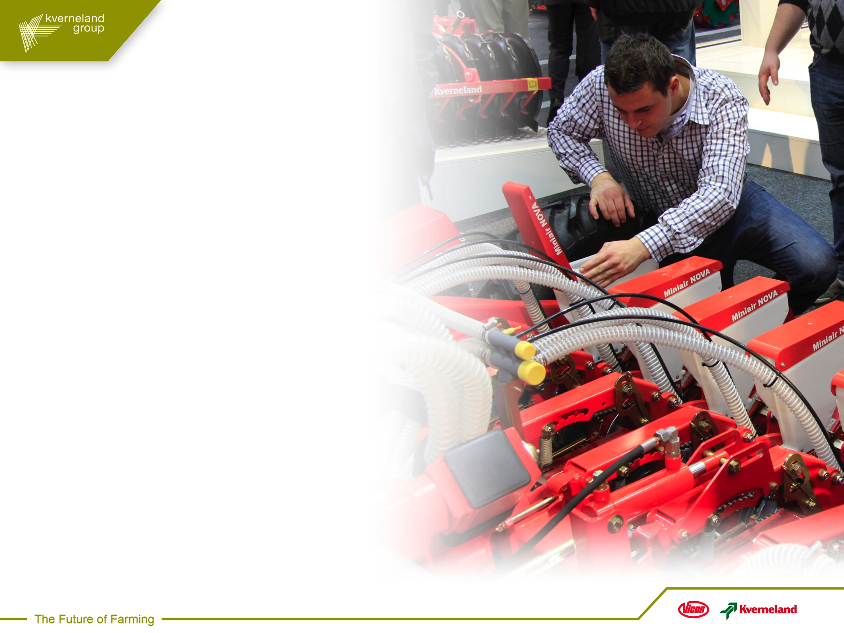
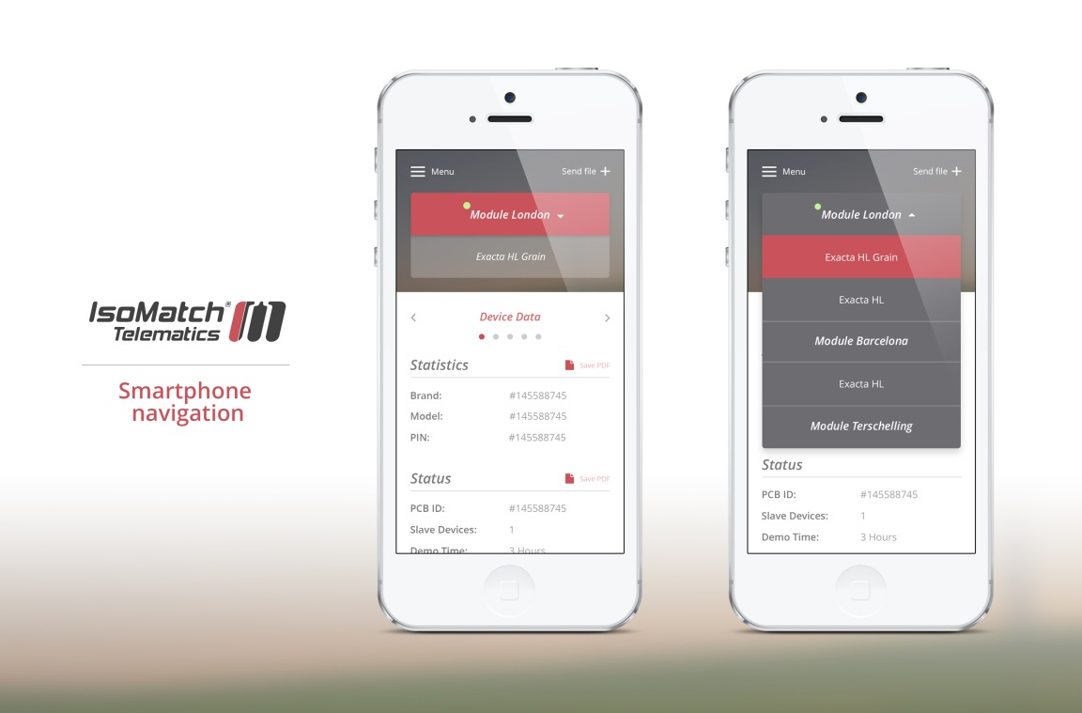
Communication platforms
Farmer registration and link to dealers
  MyKverneland.com
  MyVicon.com
Personalized experience
KvG Portal (dealer access)
Coverage of all platforms

Slide 16
Possibility for new models
Old situation
New situation
Electronics factory
Electronics factory
Machine Factory
Machine Factory
Sales Company
Sales Company
Dealer
Dealer
Customer
Customer

Slide 17
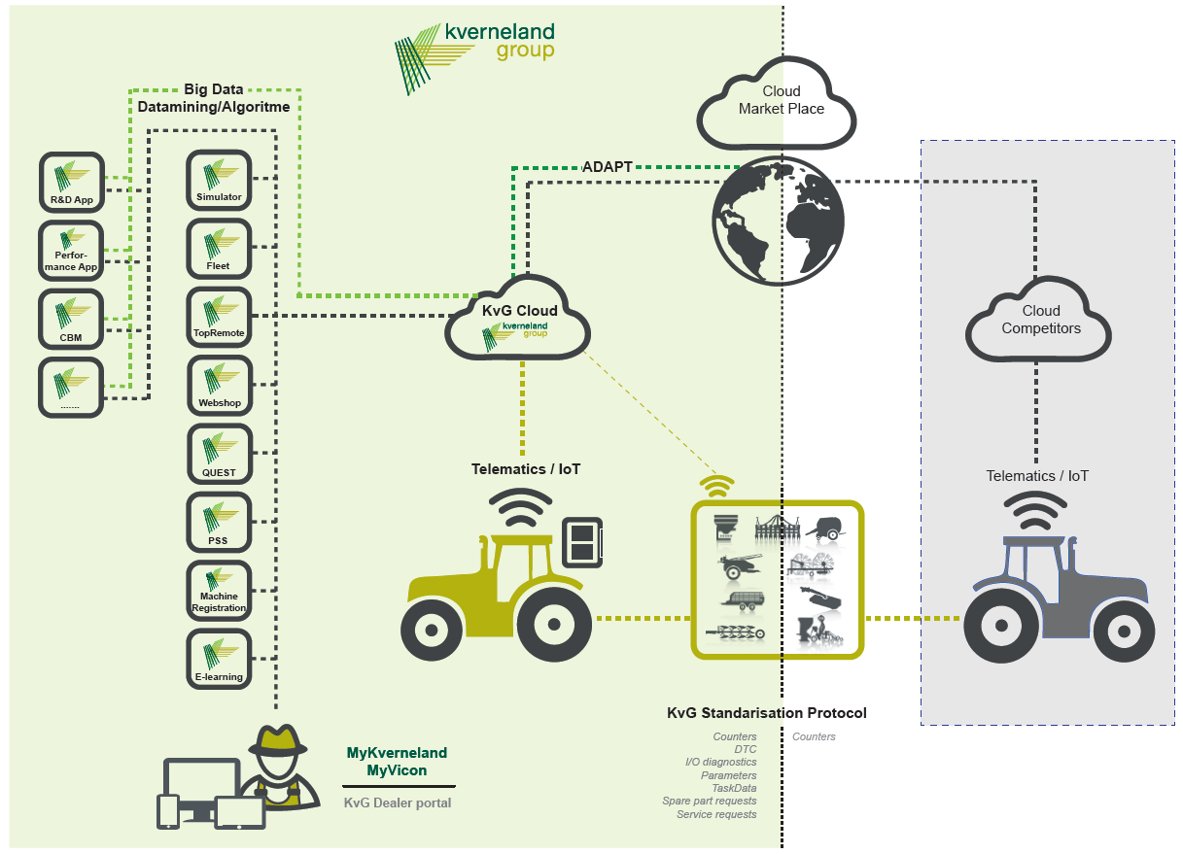

Slide 18
Data management
will become a
core competence

Slide 19
External:
Core business → Cooperation
Not core business → supplier

Slide 20
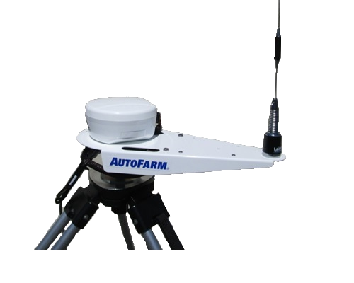
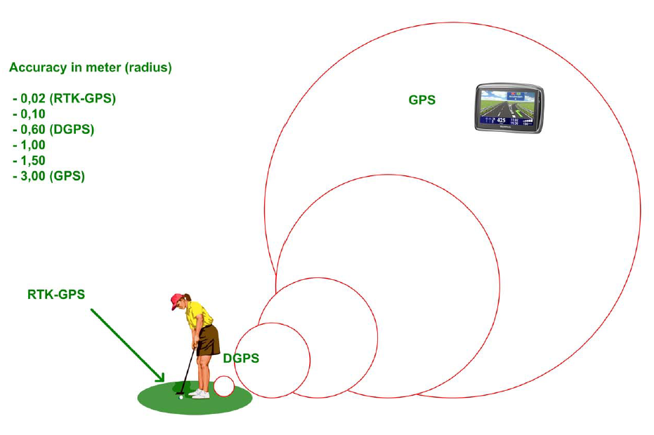



Cooperation in the Netherlands

Slide 21
4.0 applications
FleetManagement
Machine-2-Machine
Service/Parts/Maintenance alert APP
Comparison APP
Connectivity to cloud market place
Task control and follow-up
R&D APP
Condition Based Maintenance APP (combination other APP’s)
Food traceability and availability

Slide 22
Change of business models
Step 1 Getting the project started
Step 2 Utilizing the data – Maximizing profit
Step 3 Service contract – Combined with data and Service Cost Calculator
Step 4 TCO sales leasing
Step 5 Product as a Service → Price per month / Price per Ha /Price per Bale

Slide 23
Industry 4.0

Slide 24
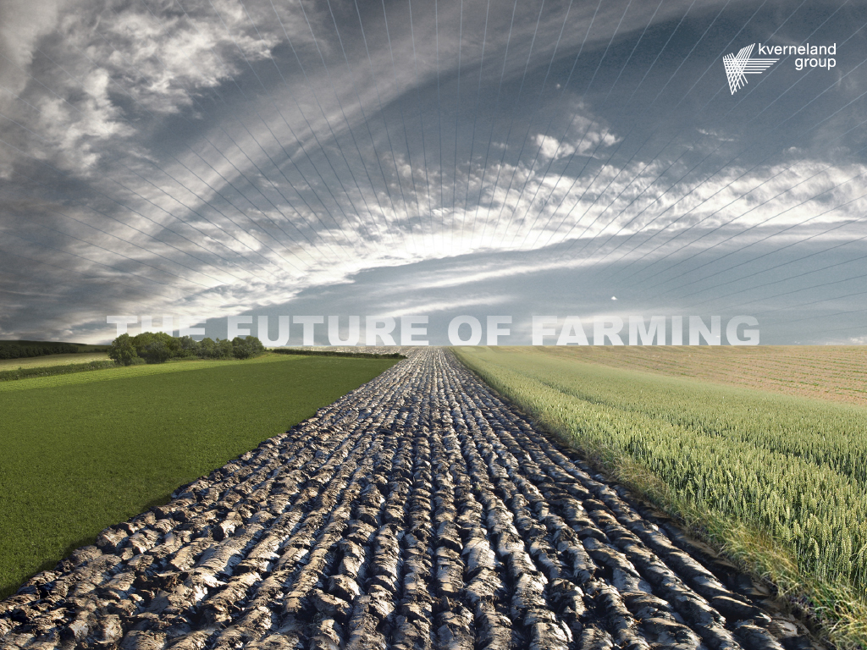
Thank you for your attention

Slide 25
Stelling 1
Samenwerkingsverbanden versnellen innovatie

Slide 26
Stelling 2
Het analyseren van “big” data zal een kerncompetentie van After Sales moeten zijn.

Slide 27
Stelling 3
Het verkrijgen van nieuwe competenties zal vooral door middel van nieuwe, jonge medewerkers moeten plaatsvinden.

